Slide 1
EPICS Database
Kay Kasemir
Many slides from Andrew Johnson, APS/ANL
Jan. 2022

Slide 2
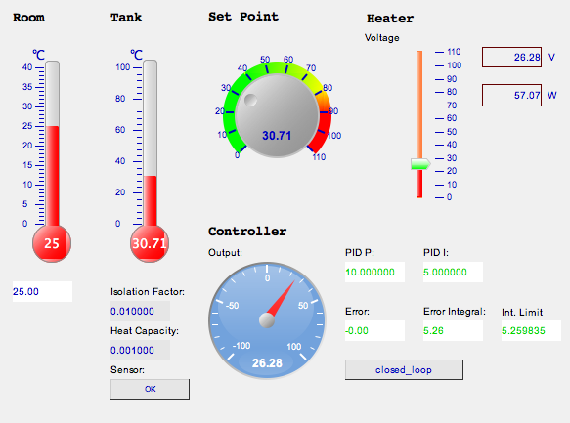
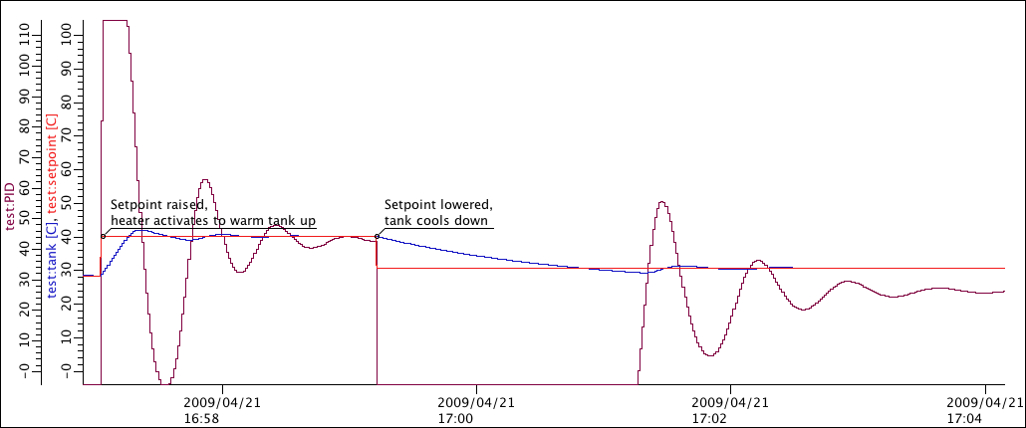
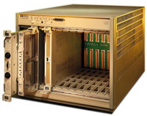
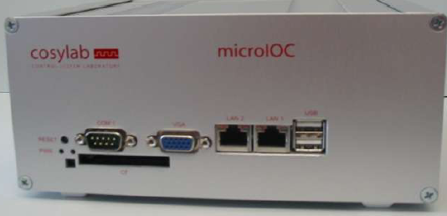
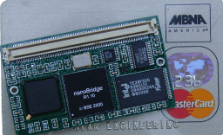
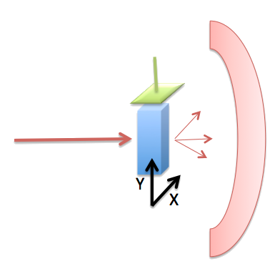
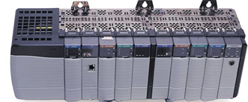

Distributed EPICS Setup
Operator Interface
Input/Output
Controller (IOC)
Channel Access
(pvAccess)

Slide 3
IOC
LAN
Database:
Data Flow,
mostly periodic
processing
Sequencer:
State machine,
mostly
on-demand
“Hard” IOCs run vxWorks and directly interface to A/D, D/A, LLRF, … hardware.
“Soft” IOCs run on Linux etc. and have no I/O Hardware other than serial or networked devices (Moxa to motor controller, …)
IOC
Channel Access, PV Access
Database
Sequencer
Device Support
I/O Hardware

Slide 4
IOC Database
'iocCore' software loads and executes 'Records'
  Configuration of records instead of custom Coding
All control system toolboxes have (better?)
  GUI tools
  Network protocols
  Hardware drivers
  but few have a comparable database!

Slide 5





Example: Basic Temperature Control
  Task:
  Read temperature
  Open/close switch as needed
  Repeat
Software?

Slide 6
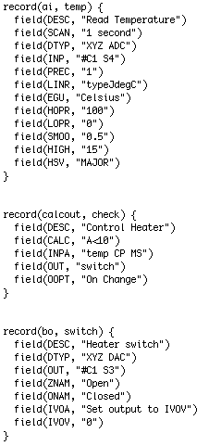
One Fishy Database
Analog Input Record
SCAN Field
Binary Output Record

Slide 7
Database = Records + Fields + Links
IOC loads and executes one or more databases
Each database has records
Each record has
  Name (unique on the whole network)
  Type (determines fields and their functionality)
  Fields (properties, can be read, most also written at runtime)
  Often device support to interface to hardware
  Links to other records

Slide 8
Records are Active
Records ‘do’ things
  Get data from other records or hardware
  Perform calculations
  Check value ranges, raise alarms
  Write to other records or hardware
  What they do depends on record type,
  field values, device support
… when they are processed
  Records process periodically or when triggered by events or other records
  No action occurs unless a record is processed

Slide 9
Example “first.db”
# The simplest record that 'does' something
# and produces changing numbers
record(calc, "$(S):random")
{
field(SCAN, "1 second")
field(INPA, "10")
field(CALC, "RNDM*A")
}
Execute: softIoc –m S=$USER –d first.db
In another terminal: camonitor $USER:random
Try dbl, dbpr, dbpf

Slide 10
Record Types
ai/ao: Analog input/output
  Read/write number, map to engineering units
bi/bo: Binary in/out
  Read/write bit, map to string
calc: Formula
mbbi/mbbo: Multi-bit-binary in/out
  Read/write 16-bit number, map bit patterns to strings
stringin/out, longin/out, seq, compress, histogram, waveform, sub, …

Slide 11
Common Fields
Design Time
  NAME: Record name, unique on network!
  DESC: Description
  SCAN: Scan mechanism
  PHAS: Scan phase
  PINI: Process once on initialization?
  FLNK: Forward link
Runtime
  TIME: Time stamp
  SEVR, STAT: Alarm Severity, Status
  PACT: Process active
  UDF: Undefined? Never processed?
  PROC: Force processing
Either
  TPRO: Trace processing, set to 1 to debug record processing

Slide 12
Record Scanning
SCAN field:
  When processed by other records:
  “Passive” (default)
  Periodically:
  “.1 second”, “.2 second”, “.5 second”,
  “1 second”, “2 second”, “5 second”, “10 second”
  On event:
  “Event” (EVNT field selects the event),
  “I/O Intr” (if device support allows this)
PHAS field
  Adds order to records that are on the same periodic scan
    First PHAS=0, then PHAS=1, …
PINI
  Set to “YES” to force record once on startup.
  Good idea for “operator input” records that are hardly ever changed, so they have an initial value.
PROC
  Writing to this field will process a record

Slide 13
Database vs. the Rest of the IOC
Record scanning runs at higher priority than Channel Access
or PV Access
  At high CPU load, PVs might not connect while records are still processed
0.1 second scan runs at higher priority than 10 second scan
PRIO field selects priority for async.
completion and
event-scanned record
Your mileage might vary
  RTOS or plain Linux?
LAN
IOC
Channel Access, PV Access
Database
Sequencer
Device Support
I/O Hardware

Slide 14
Common Input/Output Record Fields
DTYP: Device type
INP/OUT: How to read/write, format depends on DTYP
RVAL: Raw value (e.g. 16 bit integer)
VAL: Engineering unit value (e.g. 64bit float)
Output Only:
DOL: Desired Output Link.
Output records read this link to get VAL,
then write to OUT…
OMSL: .. if Output Mode SeLect = closed_loop
IVOA: Invalid Output Action
DRVL, DRVH: Drive limits

Slide 15
Extending “first.db”
# A ramp from 0 to 'limit', were limit
# can be configured via a separate record
record(ao, "$(S):limit")
{
field(DRVH, "100")
field(DOL, "10")
field(PINI, "YES")
}
record(calc, "$(S):ramp")
{
field(SCAN, "1 second")
field(INPA, "$(S):ramp")
field(INPB, "$(S):limit")
field(CALC, "A<B ? A+1 : 0")
}
Using ‘output’.
‘input’ would also work, since there’s no hardware to read or write, but only ‘output’ has DRVH…
Reading inputs:
A = my own current value
B = value of ..limit record
Which record is scanned?

Slide 16
Analog Record Fields
EGU: Engineering units name
SMOO: Smoothing
  VAL = (1-SMOO)*new_value + SMOO*last_value
  SMOO=0: VAL=new_value, default behavior
  SMOO=1: VAL=last_value, defunct behavior
  0<SMOO<1: VAL ‘smoothly’ follows latest reading
LINR: Linearization (None, Slope, breakpoint table)
  EGUL, EGUF, ESLO, EOFF: Parameters for LINR
LOLO, LOW, HIGH, HIHI: Alarm Limits
  LLSV, LSV, HSV, HHSV: Associated alarm severities

Slide 17
Binary Record Fields
ZNAM, ONAM: State name for “zero”, “one”
ZSV, OSV: Alarm severities

Slide 18
Record Links
Input or Output links may be
  Name of other record’s field: “other”, “other.VAL”, “other.A”
    If other record is in same IOC: “Database link”
    If name not found: “Channel Access link”
  Hardware link
    Details depend on device support
    DTYP field selects device support
    Format examples: “@plc12 some_tag”, “#C1 S4”
Input links may be
  Constant number: “0”, “3.14”. “-1.6e-19”
A record’s FLNK field processes another record after current record is ‘done’

Slide 19
Database Links
Format: “record.field {flags}”
  VAL is default for field
Flags:
  PP: Process a passive target record
    INP, DOL: Before reading
    OUT: After writing
  NPP: non-process-passive (default)
  MS: Maximize severity (should be the default?)
  NMS: non-MS (default)
  MSS: Maximize Severity and Status
  MSI: .. when severity = INVALID (should be the default?)
Example:
  field(“INP”, “other_rec.VAL PP MS”)

Slide 20
Channel Access Links
When linked record is not in this IOC,
automatically uses Channel Access link
Flags:
  PP: Ignored. Not triggering processing on other IOC
  MS, MSI: Maximize severity (when INVALID)

Slide 21
Channel Access Link Flags
CA: Force CA link, even though target in same IOC
  Can be used to break ‘lock sets’
CP: For INP link, process on received CA monitor
  Typically to cause processing when linked value changes. Details depend on MDEL of source.
CPP: CP, but only if SCAN=Passive

Slide 22
Forward Links
Trigger processing, not passing data
Destination processed if SCAN=Passive
May use CA links
  Must use FLNK=“other.PROC” (other IOC)
  or FLNK=“other.PROC CA” (same IOC)
  Always triggers processing even for SCAN!=Passive

Slide 23
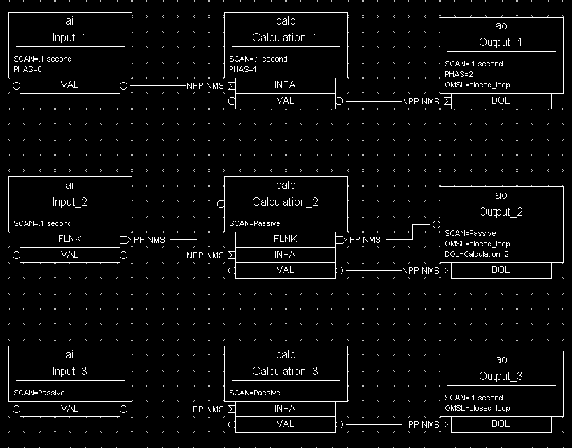
Processing chains

Slide 24
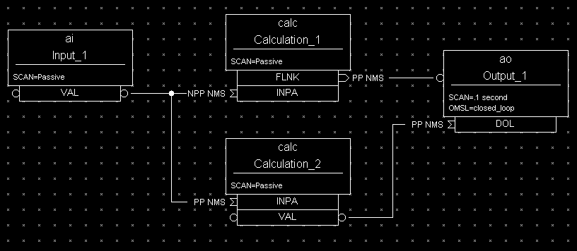
Which record is never processed?

Slide 25
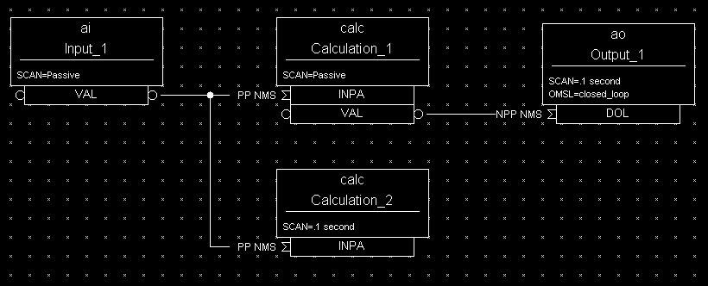
How often is Input_1 processed?

Slide 26
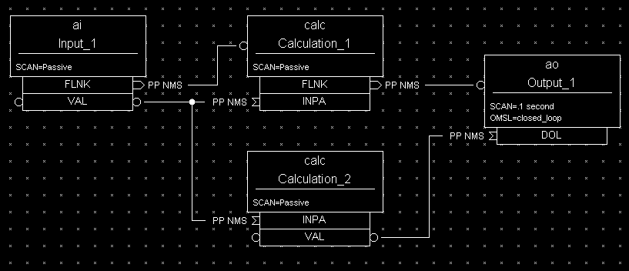
How long will this take?
PACT: Processing Active

Slide 27
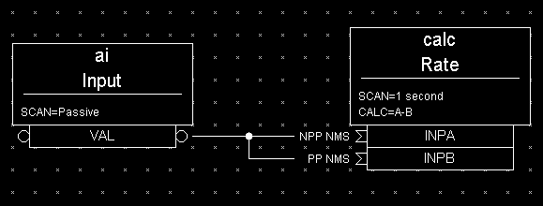
Rate Of Change Example
Calculating “Rate-of-Change” of an Input
INPA fetches data that is 1 second old because it does not request processing of the AI record. INPB fetches current data because it requests the AI record to process. The subtraction of these two values reflects the ‘rate of change’ (difference/sec) of the pressure reading.

Slide 28
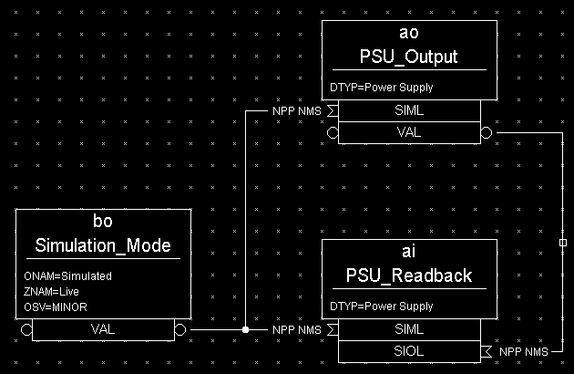
Simulation Mode
When in simulation mode, the AO record does not call device support and the AI record fetches its input from the AO record.

Slide 29
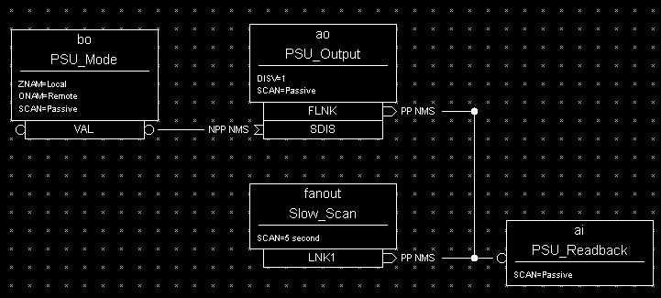
Multiple Scan Triggers
Slow Periodic Scan with Fast Change Response
The AI record gets processed every 5 seconds AND whenever the AO record is changed. This provides immediate response to an operator's changes even though the normal scan rate is very slow. Changes to the power supply settings are inhibited by the BO record, which represents a Local/Remote switch.

Slide 30
Device Support
Records (AI, AO, ..) on their own only read/write from other records
Device support connects them to hardware
Hardware Device support is outside of EPICS ‘base’. Added to IOC as needed.
DTYP selects a device support module
INP/OUT provides detail

Slide 31
Synchronous vs. Asynchronous I/O
“Fast”, synchronous device support reads or writes the VAL of a record when the record is processed.
“Slow”, async support starts reading or writing when the record is processed. The record remains in PACT=true state, and device support triggers completion of processing when data has been read/written.
Channel Access ‘get/put’ reads/writes current VAL, no matter if record is processing
Channel Access ‘get/put callback’ will complete once processing completes

Slide 32
‘Soft’ Device Support
EPICS base includes DTYP=
“Soft Channel” for AI, AO, BI, BO, ..
  Reads/writes the VAL field
“Raw Soft Channel” for AI, AO, BI, BO, ..
  Reads/writes the RVAL field, converts to/from VAL
“Async Soft Channel” for AI, AO, BI, BO, ..
  Performs a get/put callback, waits for completion

Slide 33
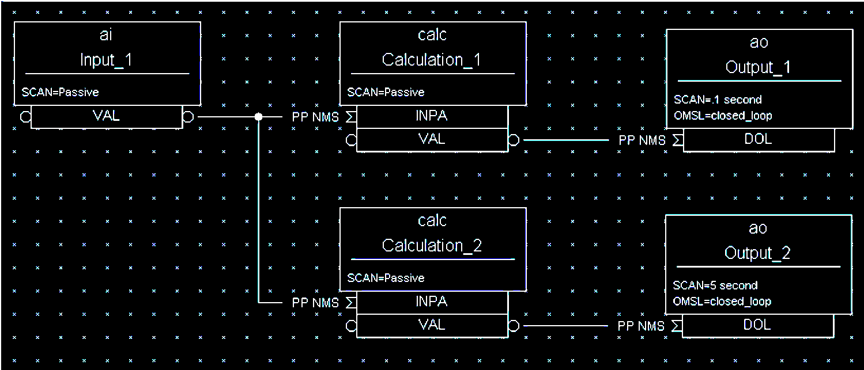
What could go wrong here?

Slide 34
Lock-Sets
Group of records connected by links
Processing a record locks its lock-set
  Prevents processing by multiple threads
  Similar but technically separate from PACT
Tends to transparently avoid problems
  .. Unless you are very unlucky.
  Then use “CA” flag to break lock set

Slide 35
Record Locking vs. PACT
Depending on its device support, a record can “process” for a long time
  Processing sets PACT and triggers driver to fetch data.
  Some time later driver processes the record again, and clears PACT.
Records in lock-set are locked while
  Processing starts, then again when it completes, but not in the in-between times
  Reading a field
  Writing a field

Slide 36
Alarms
Common fields:
  SEVR: Alarm Severity
    NONE, MINOR, MAJOR, INVALID
  STAT: Alarm Status
    UDF, READ, WRITE, CALC, HIGH, STATE, …
Binary records:
  ZSV, OSV: Severity for ‘zero’ and ‘one’ state
Analog records:
  LOLO, LOW, HIGH, HIHI: Thresholds
  LLSV, LSV, HSV, HHSV: Associated severities
  HYST: Hysteresis

Slide 37



Alarm Example
# Raise alarms when temperature near boiling point
record(ai, "$(user):tank")
{
field(DESC,"Water Temperature")
field(SCAN, "…
field(INP, "…
field(EGU, "C")
field(PREC, "1")
field(HIGH, "90")
field(HSV, "MINOR")
field(HIHI, "100")
field(HHSV, "MAJOR")
}

Slide 38
Monitor Dead-Bands
Analog records send updates to CA clients
  MDEL Change threshold for most clients
  ADEL .. for archive client

Slide 39
Record Hints
Use AO, analog output, for user input
  DRVL, DRVH can limit the value range
BO record can be used as timer
  HIGH field:
  When writing VAL=1, remains 1 for HIGH seconds
  Useful for operator interface buttons:
  Button writes 1, record reverts to 0 after HIGH=1

Slide 40
Record Hints
MBBI, MBBO records map states
Define values and states via
ZRVL/ZRST, ONVL/ONST, TWVL/TWST, …
Can be used like BI/BO:
ZRVL=0, ONVL=1, ZRST ⬄ ZNAM, ONST ⬄ ONAM
.. For values other than 0, 1:
ZRVL=0, ONVL=255
Decode Limit Switch state from bits:
ZRVL = 0 ZRST = “Moving”
ONVL= 1 ONST=“At Left Limit”
TWVL = 2 TWST=“At Right Limit”
THVL = 3 THST = “Broken”, THSV=MAJOR

Slide 41
Record Hints
Use CALCOUT for if-then-else logic
  INP* and CALC as in CALC record
  OOPT “On Change”, “When Zero”, “Transition to Zero” etc.
  Output can either use CALC or a separate OCAL
SEQ, FANOUT, DFANOUT can process a list of records
  Simply process or writing values
  SEL can change from processing all to processing selected records

Slide 42
Record Hints
COMPRESS record can
  Keep last N values in circular buffer
  Compute average, min or max of array
ASUB record can call C code
  INAM, SNAM: Name of initial() and sub()
  Many INP* and VAL* fields
EVENT record can post database event
  Trigger records with
  SCAN=Event and EVNT=that event

Slide 43
Calcout Record Details
Combines calc record with analog output functionality
  INPA, INPB, …, INPL and CALC to compute VAL
  OUT to which VAL is written
OOPT determines if/when OUT is written
  “Every Time”, “On Change”, “When Non-zero”, “Transition to Zero”, …
By default, VAL is written, but can also configure
  field(OCAL, “A/B+…”) computes alternate OVAL
  field(DOPT, “Use OCAL”) selects writing OVAL instead of VAL to OUT
➔ Two calculations and an ‘if’ type selector within one record

Slide 44
Calcout Example
record(calcout, “Corrector”)
{
field(SCAN, “.1 second”)
field(INPA, “Enable”)
field(INPB, “Setpoint”)
field(INPC, “Readback”)
field(INPD, “17.54”)
field(CALC, “A”)
field(OOPT, “When Non-zero”)
field(DOPT, “Use OCAL”)
field(OCAL, “D*(B-C)”)
field(OUT, ”SteeringMagnet PP”)
}
➔ CALC to determine if we should do anything,
OCAL for actual computation

Slide 45
‘synApps’ Records outside of EPICS base
MOTOR record
  A whole ecosystem for controlling motors
BUSY record can be used to support put-callback
  Some Setpoint record FLNKs to logic that sets BUSY record = 1
  When device reaches setpoint, set BUSY record VAL=0
  ➔ CA ‘put-callback’ to setpoint will complete
  after device reaced the setpoint

Slide 46
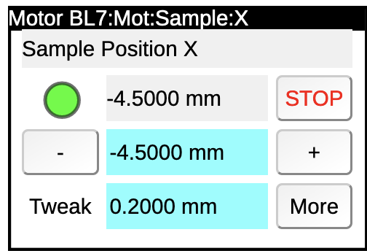
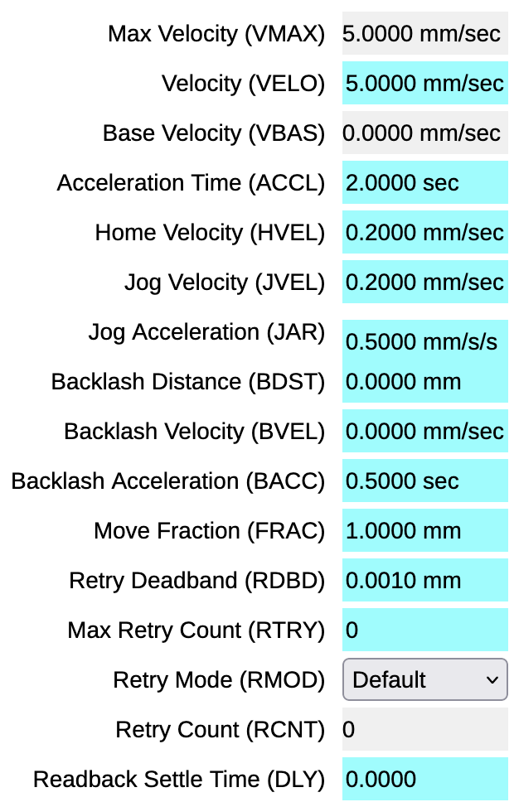
Motor Record Details
Record of 100+ fields https://epics.anl.gov/bcda/synApps/motor/motorRecord.html
Basic control
  VAL Desired motor position. Supports put-callback
  RBV Readback value, actual motor position
  DONE Are we done moving the motor?
  HLS, LLS Are we at the high or low limit?
  STOP
Resolution
  MRES, DIR, OFF, EGU… Turn motor ticks into “mm” or “degrees”
  Is it a stepper motor or servo? Do we have an encoder, how is it calibrated?
Motion
  VBAS, VMAX, ACCL, HVEL, JVEL, … Speed, acceleration
  HLM, LLM, … Limits of motion range
  BDST, BACC, RTRY, .. Backlash compensation, retries
More: Homing, “jog”, “tweak”, status,

Slide 47
Large or small Records?
One Motor Record?
  motor.VAL Setpoint
  motor.RBV Readback
  motor.DONE Done?
  motor.HLS At high limit?
  motor.MRES Steps per unit
  …
Collection of Records?
  record(ao, “$(M)_Set”)
  record(ai, “$(M)_Pos”)
  record(bi, “$(M)_Done”)
  record(bi, “$(M)_AtHighLim”)
  record(ao, “$(M)_StepsPerUnit”)
  record(waveform, “$(M)_Profile”)
A servo motor doesn’t use steps per unit.
A stepper might support a motion profile
➔ There is no commonly shared “Power Supply”, “Camera”, “PID”, .. record.
Preferred approach is collection-of-records.

Slide 48
Time Stamps
TIME is generally set to the time when the record last processed
TSE=-2
  Device support already set the TIME, for example to the exact trigger time obtained from hardware
TSE=1…255
  Set TIME to the last occurrence of event 1..255, obtained from timing system
TSEL
  Allows fetching the time stamp from another record

Slide 49
Linear Conversion
Analog records convert RVAL ⬄ VAL
LINR=NO CONVERSION
  VAL = RVAL
LINR=SLOPE
  VAL = (RVAL)*ESLO + EOFF
This assumes device support populates the (integer) RVAL field.
If device support already has a floating-point value, it places that in the (double) VAL field.
For additional conversions, then use a CALC record.

Slide 50
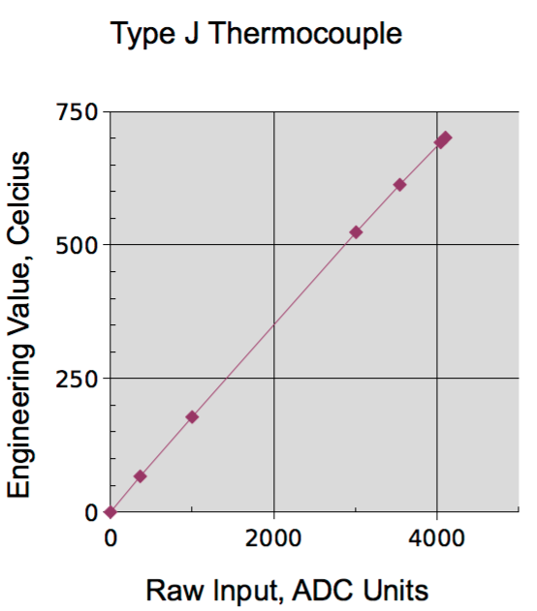
Breakpoint Tables
Analog records can set
LINR= typeKdegC
with this in a *.dbd file:
breaktable(typeKdegC)
{
0.000000 0.000000
299.268700 74.000000
660.752744 163.000000
1104.793671 274.000000
1702.338802 418.000000
2902.787322 703.000000
3427.599045 831.000000
...
}

Slide 51
Summary
Database Records configure the IOC’s data flow
  Fields, links instead of custom code
There’s more
  Fields MDEL/ADEL, bo.HIGH
  Access security
See https://epics-controls.org for
  IOC Application Developers’ Guide
  Record Reference Manual,
  https://epics.anl.gov/base/R7-0/6-docs/RecordReference.html

